Slide 1
Dimensionality Reduction
Fereshteh Sadeghi
CSEP 546

Slide 2
Motivation
Clustering
One way to summarize a complex real-valued data point with a single categorical variable
Dimensionality reduction
Another way to simplify complex high-dimensional data
Summarize data with a lower dimensional real valued vector

Slide 3
Motivation
Clustering
One way to summarize a complex real-valued data point with a single categorical variable
Dimensionality reduction
Another way to simplify complex high-dimensional data
Summarize data with a lower dimentional real valued vector
Given data points in d dimensions
Convert them to data points in r<d dimensions
With minimal loss of information

Slide 4
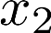
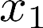
Data Compression
Reduce data from
2D to 1D
(inches)
(cm)
Andrew Ng

Slide 5
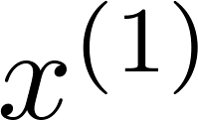
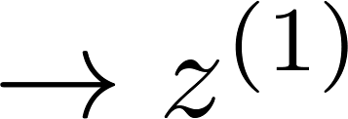
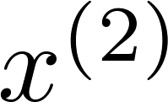
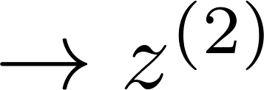
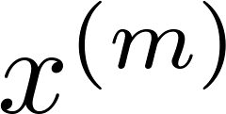
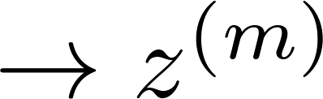
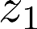
Data Compression
Reduce data from
2D to 1D
(inches)
(cm)
Andrew Ng
Notes:
Add more unique colors (3-4)

Slide 6
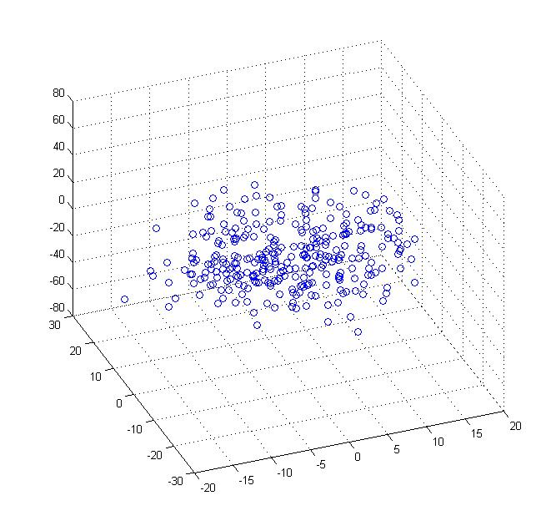
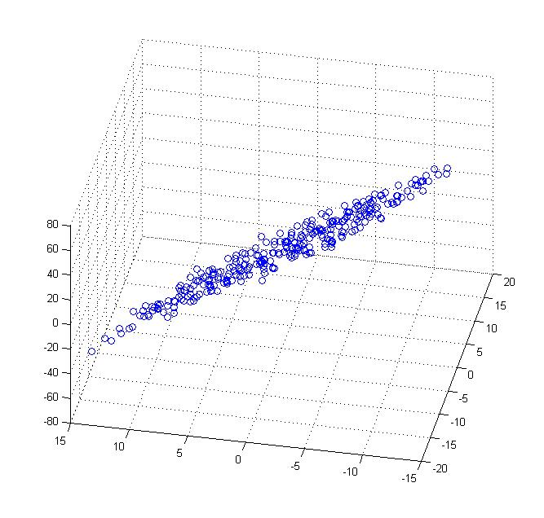
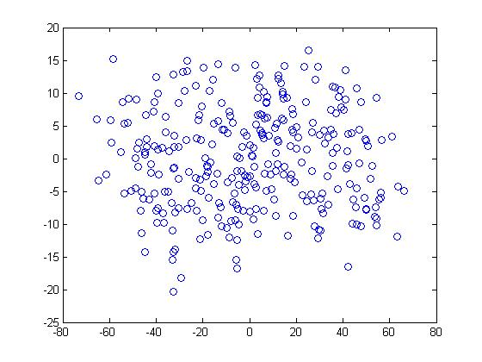
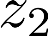
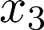
Data Compression
Reduce data from 3D to 2D
Andrew Ng
Notes:
Pca3d2d in lecture-slides/assets/pca/
Label axes

Slide 7

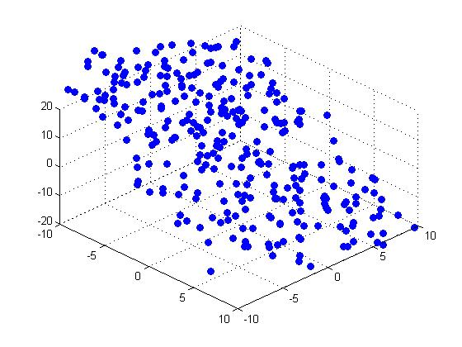

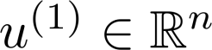
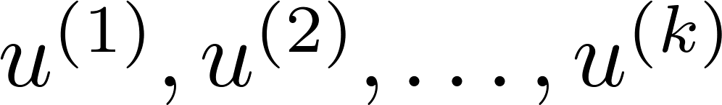
Principal Component Analysis (PCA) problem formulation
Reduce from 2-dimension to 1-dimension: Find a direction (a vector )
onto which to project the data so as to minimize the projection error.
Reduce from n-dimension to k-dimension: Find vectors
onto which to project the data, so as to minimize the projection error.
Andrew Ng
Notes:
Change numbers to LATEX as well

Slide 8
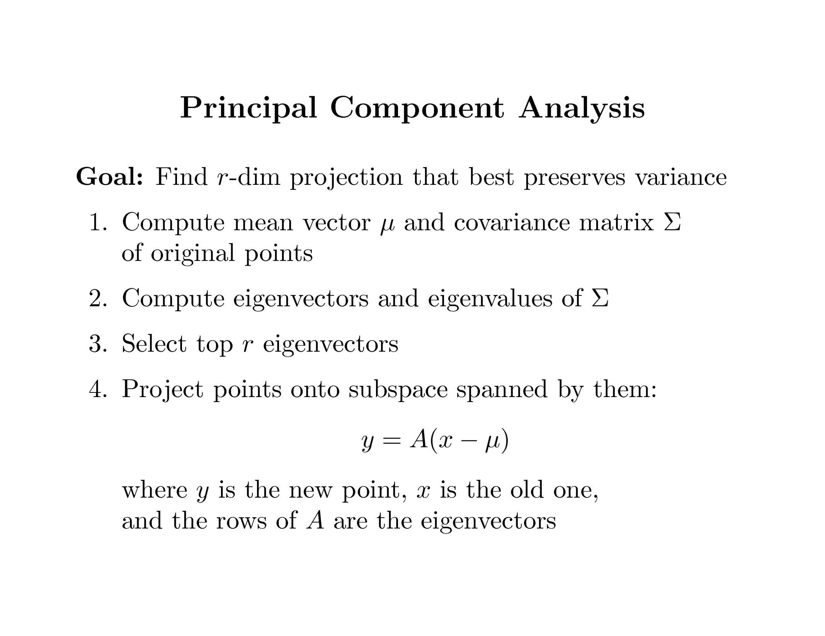

Slide 9
Covariance
Variance and Covariance:
Measure of the “spread” of a set of points around their center of mass(mean)
Variance:
Measure of the deviation from the mean for points in one dimension
Covariance:
Measure of how much each of the dimensions vary from the mean with respect to each other
Covariance is measured between two dimensions
Covariance sees if there is a relation between two dimensions
Covariance between one dimension is the variance

Slide 10
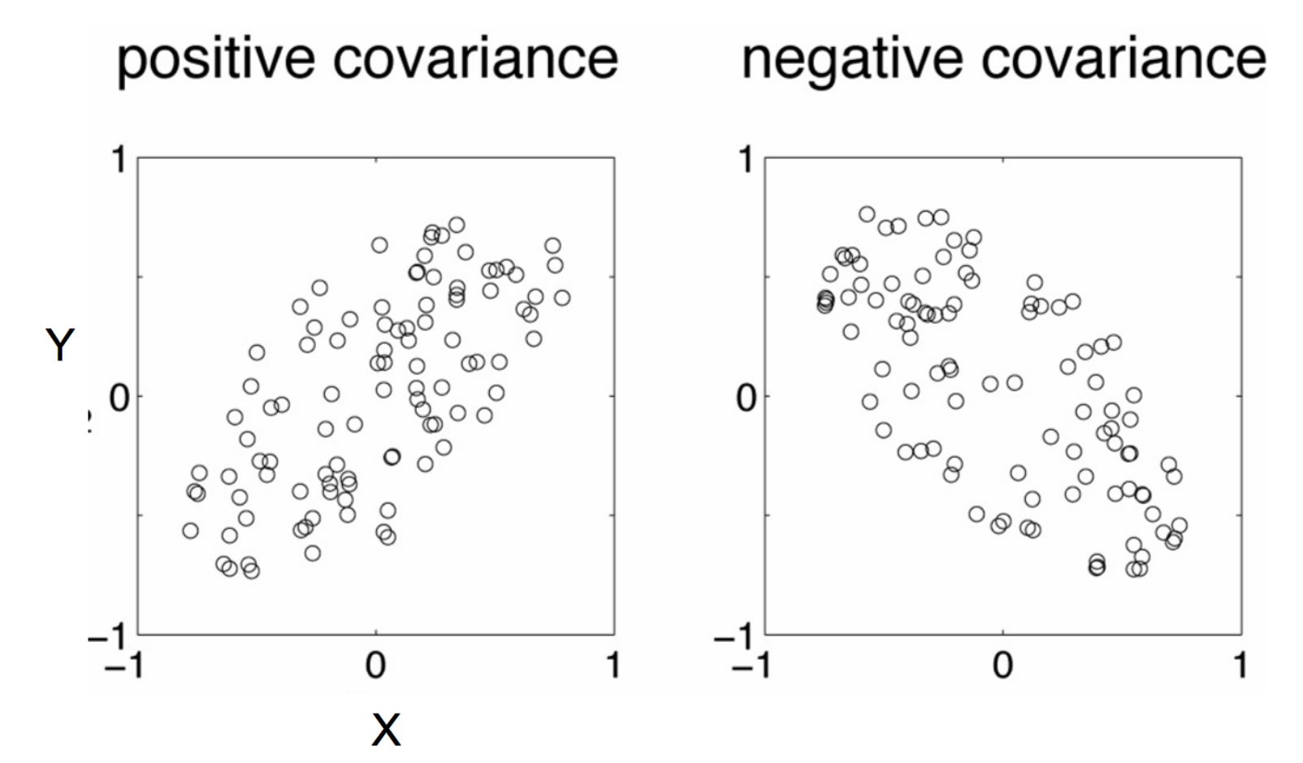
Positive: Both dimensions increase or decrease together
Negative: While one increase the other decrease

Slide 11
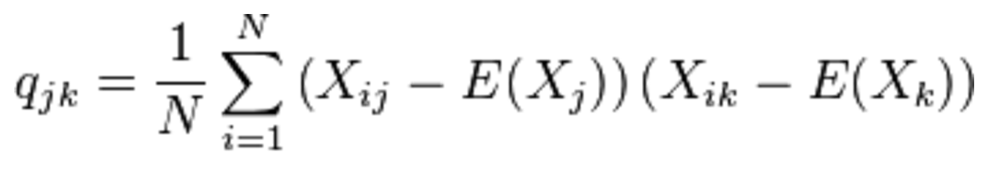
Covariance
Used to find relationships between dimensions in high dimensional data sets
The Sample mean

Slide 12
Eigenvector and Eigenvalue
Ax = λx
A: Square Matirx
λ: Eigenvector or characteristic vector
X: Eigenvalue or characteristic value
The zero vector can not be an eigenvector
The value zero can be eigenvalue

Slide 13
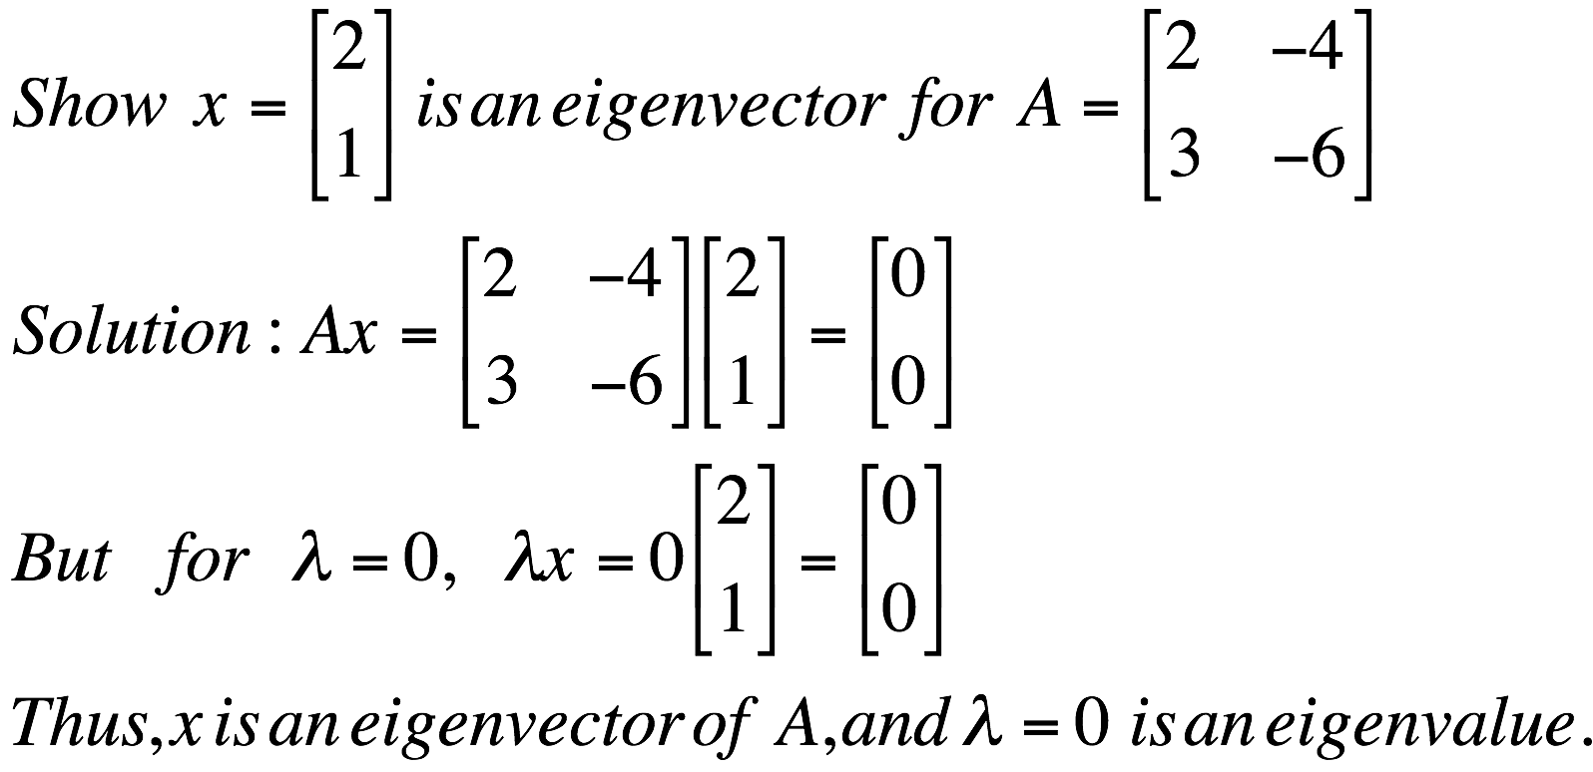
Eigenvector and Eigenvalue
Ax = λx
A: Square Matirx
λ: Eigenvector or characteristic vector
X: Eigenvalue or characteristic value
Example

Slide 14

Eigenvector and Eigenvalue
Ax - λx = 0
(A – λI)x = 0
Ax = λx
B = A – λI
Bx = 0
If we define a new matrix B:
x = B⁻¹0 = 0
BUT! an eigenvector cannot be zero!!
If B has an inverse:
x will be an eigenvector of A if and only if B does not have an inverse, or equivalently det(B)=0 :
det(A – λI) = 0

Slide 15
Eigenvector and Eigenvalue
Example 1: Find the eigenvalues of
two eigenvalues: −1, − 2
Note: The roots of the characteristic equation can be repeated. That is, λ₁ = λ₂ =…= λ_{k}. If that happens, the eigenvalue is said to be of multiplicity k.
Example 2: Find the eigenvalues of
λ = 2 is an eigenvector of multiplicity 3.

Slide 16
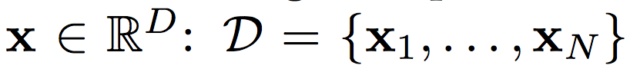
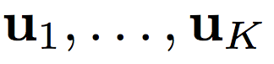
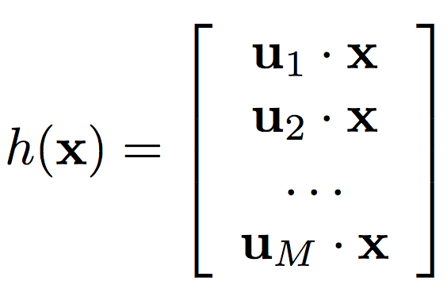
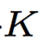
Principal Component Analysis
Input:
Set of basis vectors:
Summarize a D dimensional vector X with K dimensional feature vector h(x)

Slide 17
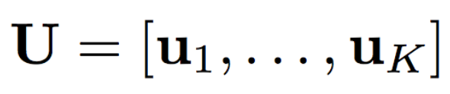
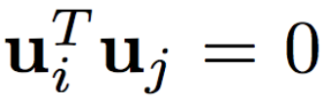
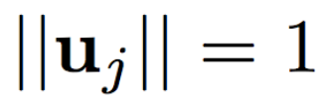
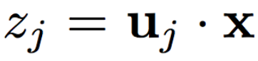
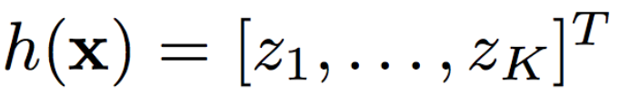
Principal Component Analysis
Basis vectors are orthonormal
New data representation h(x)

Slide 18
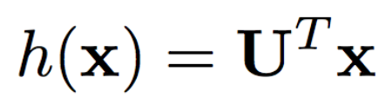
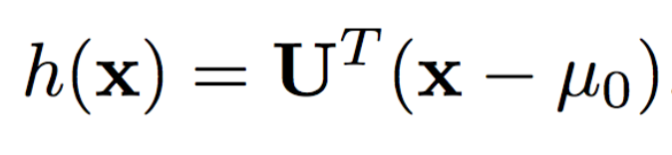
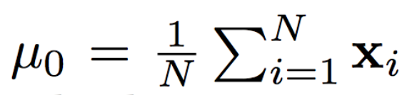
Principal Component Analysis
New data representation h(x)
Empirical mean of the data

Slide 19
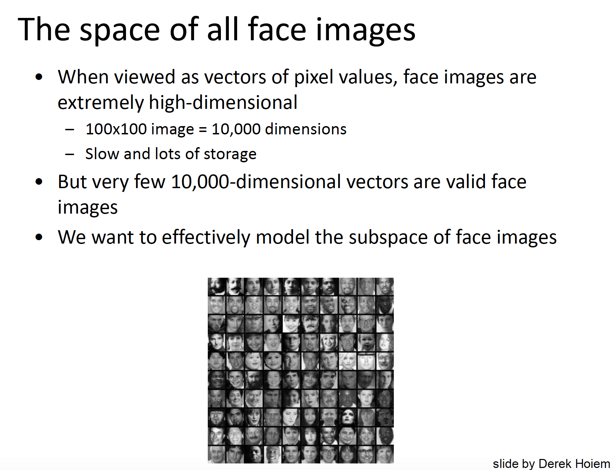

Slide 20
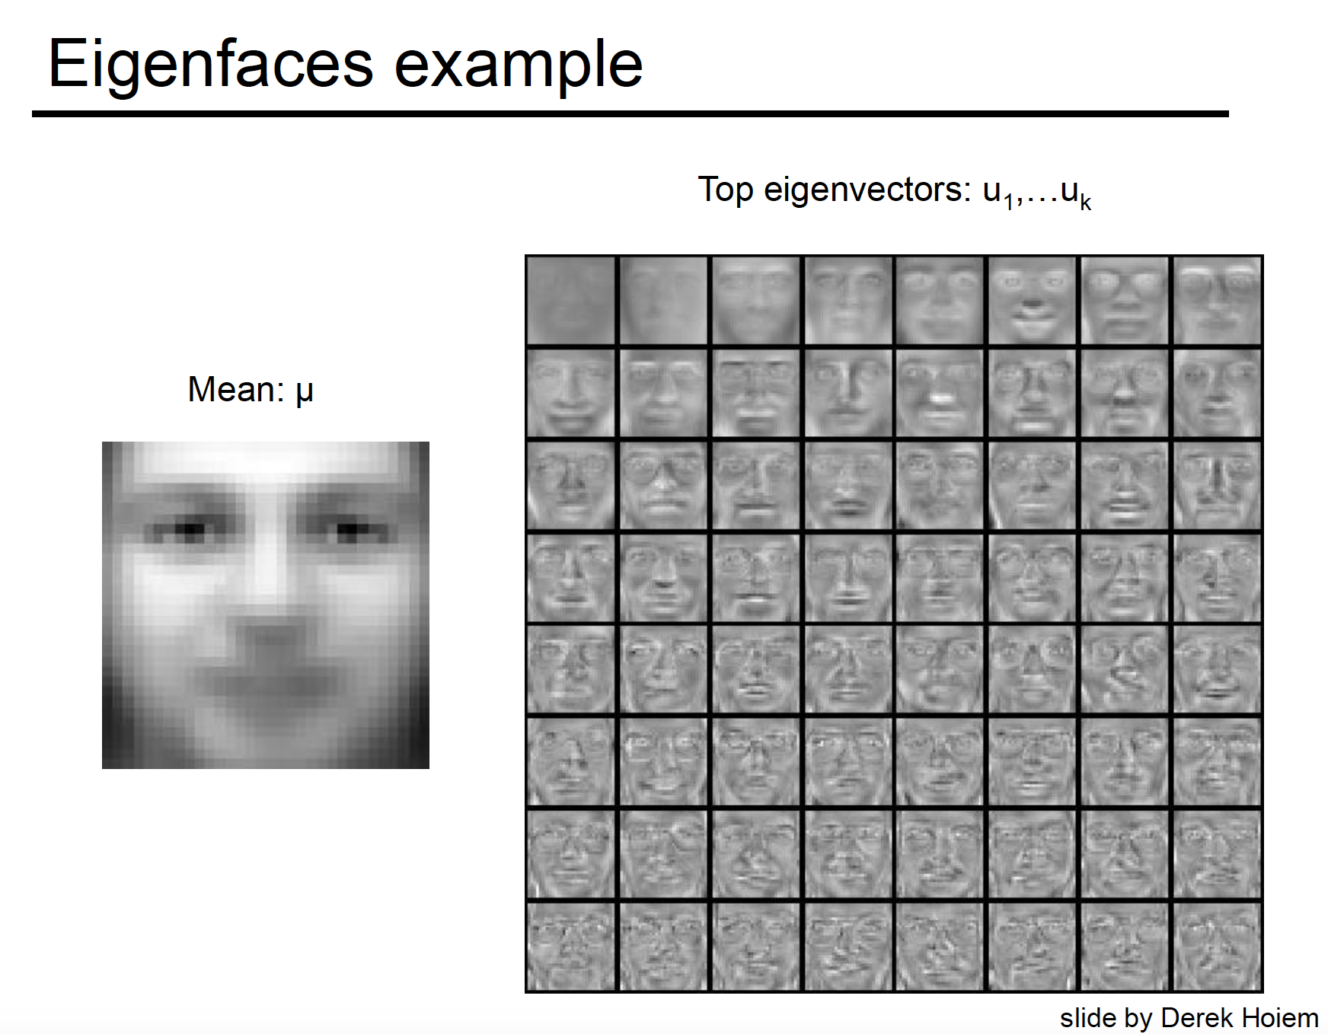

Slide 21
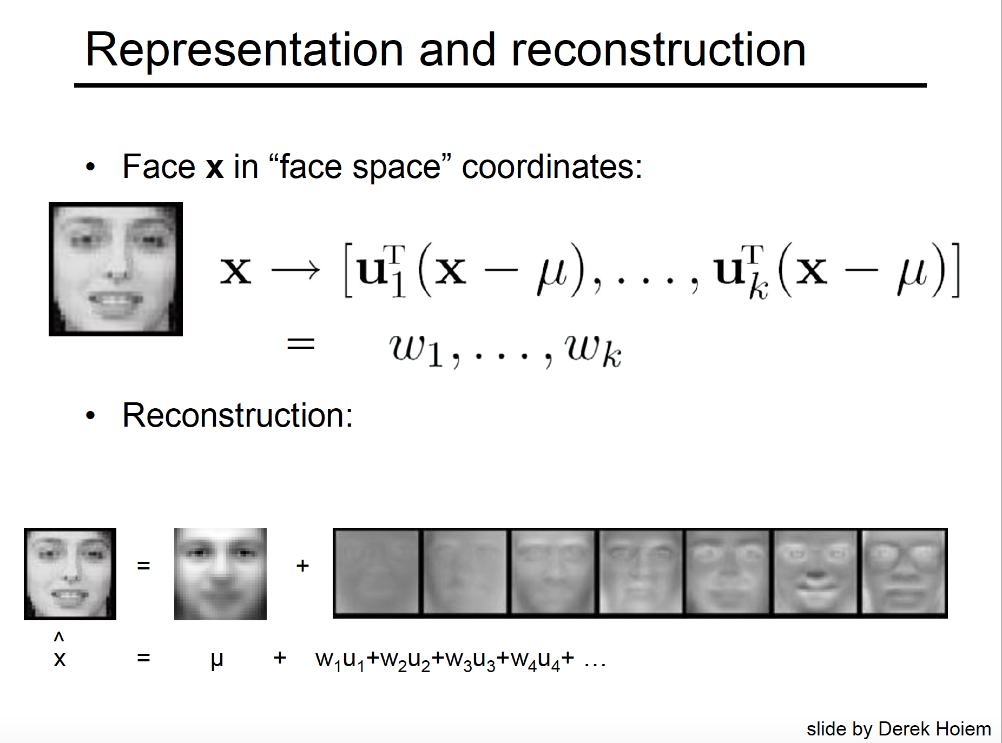

Slide 22
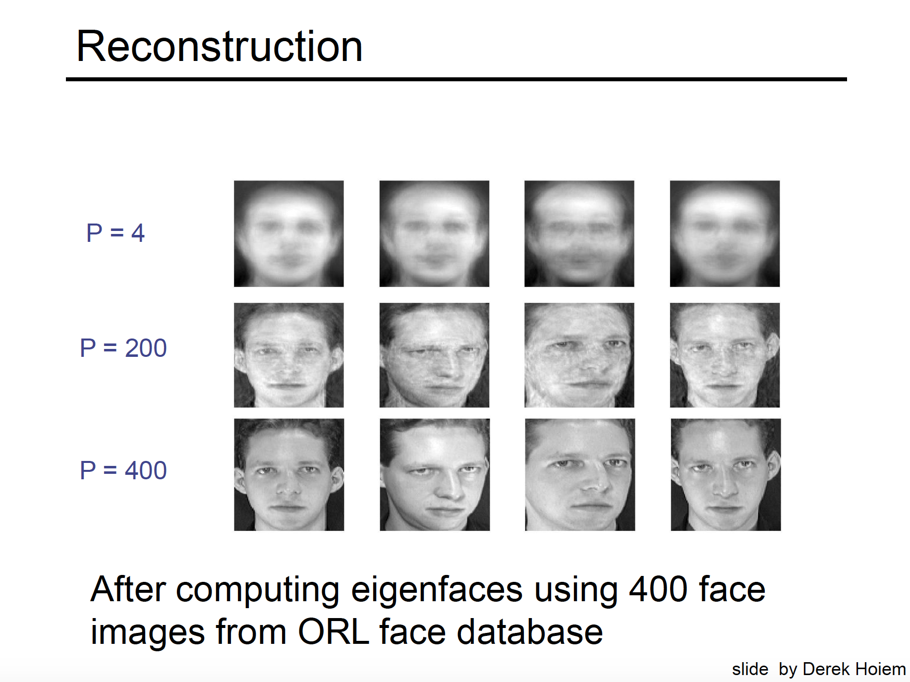

Slide 23
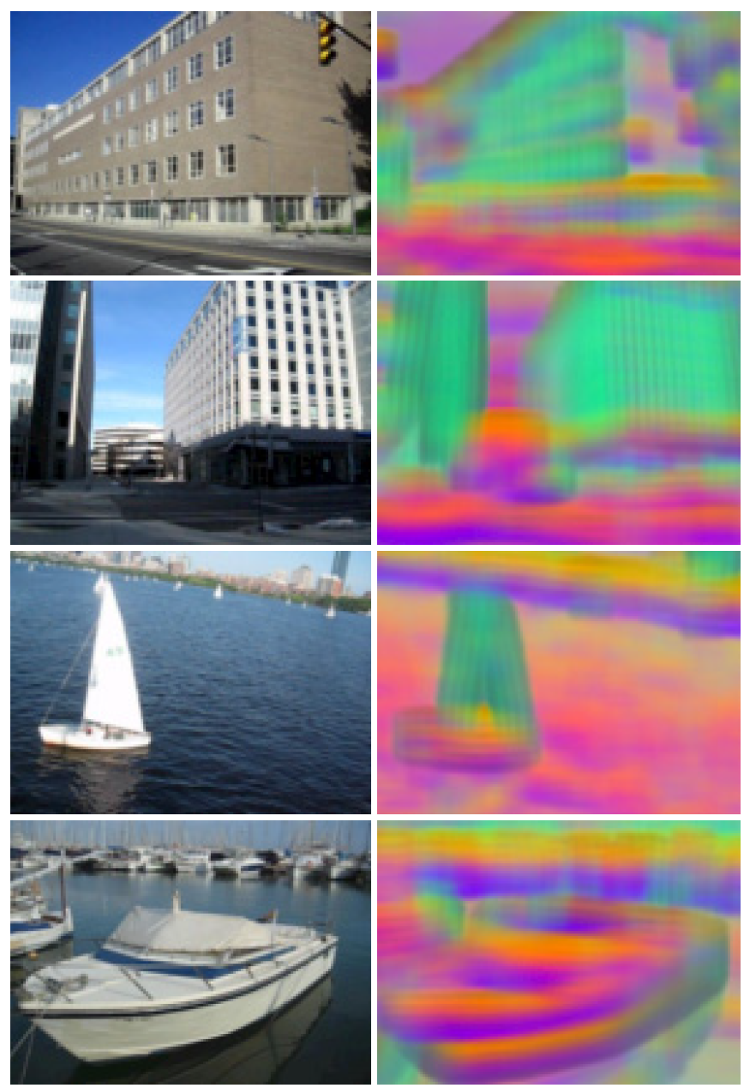
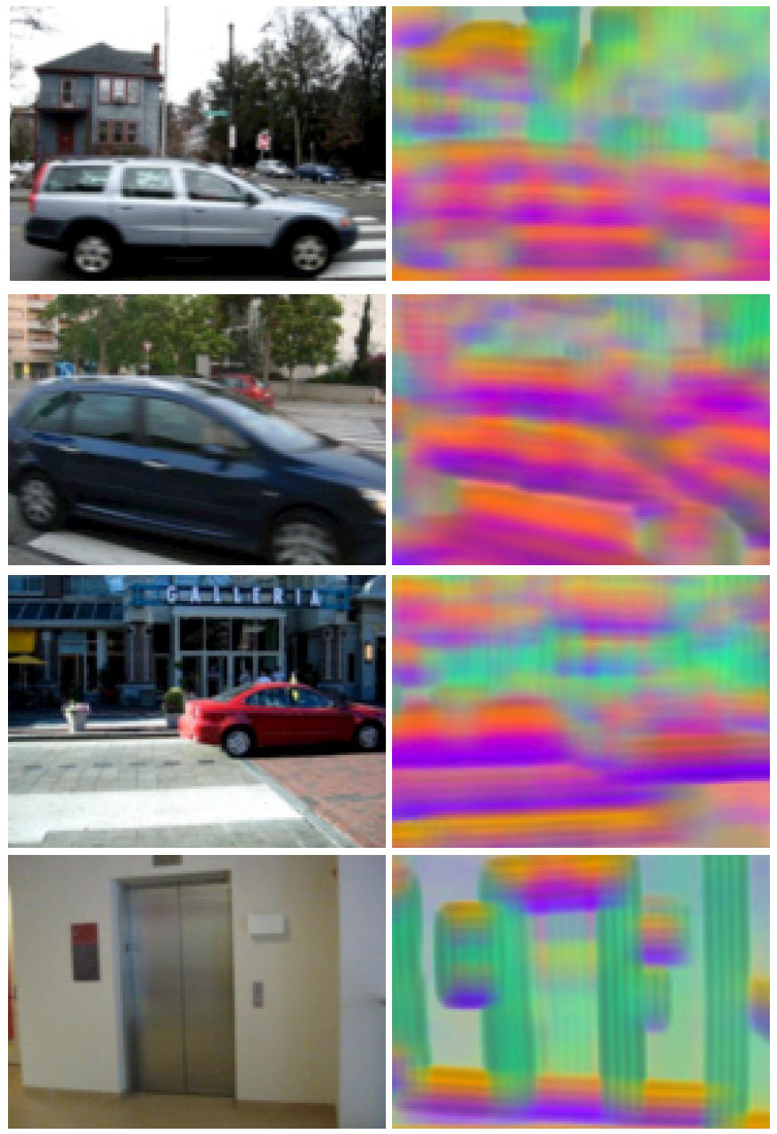
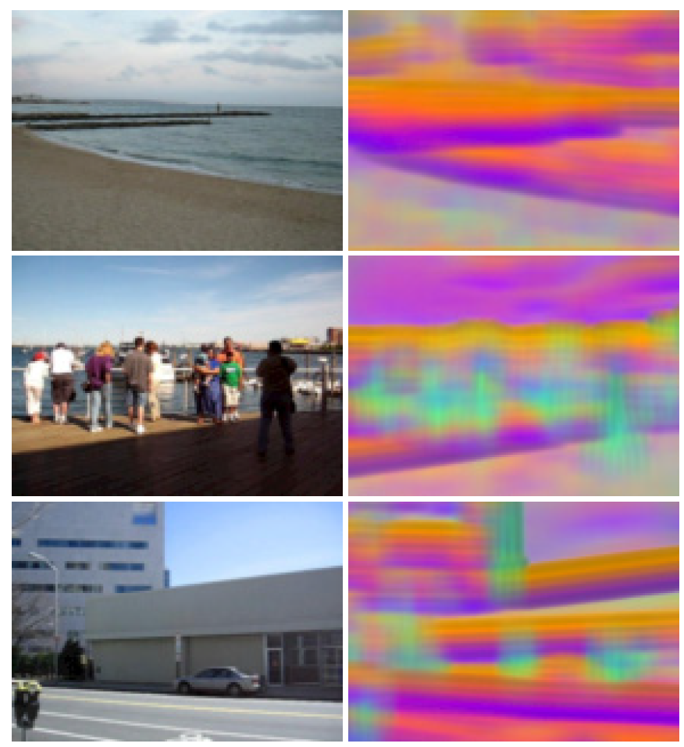

SIFT feature visualization
The top three principal components of SIFT descriptors from a set of images are computed
Map these principal components to the principal components of the RGB space
pixels with similar colors share similar structures

Slide 24

Original Image
Application: Image compression
Divide the original 372x492 image into patches:
Each patch is an instance that contains 12x12 pixels on a grid
View each as a 144-D vector

Slide 25

PCA compression: 144D → 60D

Slide 26

PCA compression: 144D → 16D

Slide 27
16 most important eigenvectors

Slide 28

PCA compression: 144D ) 6D

Slide 29
6 most important eigenvectors

Slide 30
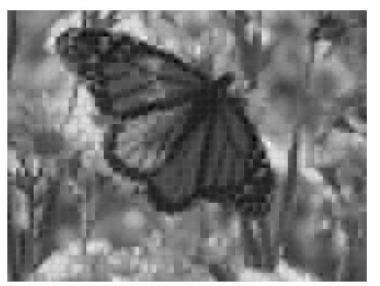
PCA compression: 144D → 3D

Slide 31
3 most important eigenvectors

Slide 32
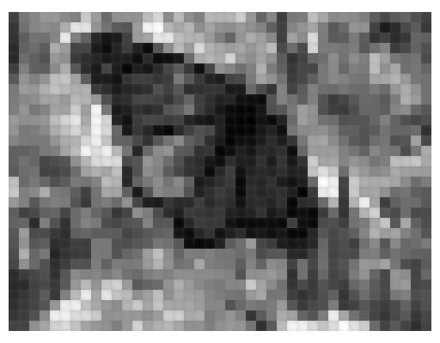
PCA compression: 144D → 1D

Slide 33
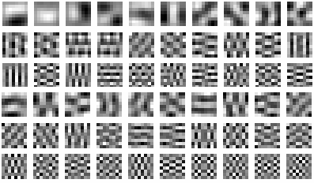
60 most important eigenvectors
Looks like the discrete cosine bases of JPG!...

Slide 34
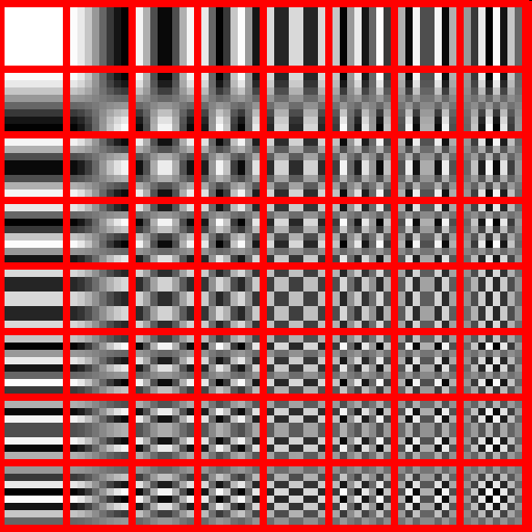
2D Discrete Cosine Basis
http://en.wikipedia.org/wiki/Discrete_cosine_transform

Slide 35
Dimensionality reduction
PCA (Principal Component Analysis):
Find projection that maximize the variance
ICA (Independent Component Analysis):
Very similar to PCA except that it assumes non-Guassian features
Multidimensional Scaling:
Find projection that best preserves inter-point distances
LDA(Linear Discriminant Analysis):
Maximizing the component axes for class-separation
…
…

